Slide 1
Multiplication Check Workshop
Tuesday 17th October, 2023

Slide 2
Aims of the Session.
Understand the nature of the statutory multiplication check.
Understand how to use Times Tables Rock Stars to support your child in learning their multiplication facts.
Gain some tips to help support your child to become better at recall of multiplication facts.
Understand how we will continue to support your child in school.

Slide 3
About the multiplication check.
In June, all children in Year 4 in England, will be required to complete a multiplication check.
The children have already had experience of this task as they has completed a baseline assessment using the multiplication checker app on Maths Frame.
We will continue to work hard with your children to ensure that they will be as ready as they can be to partake in the test.

Slide 4
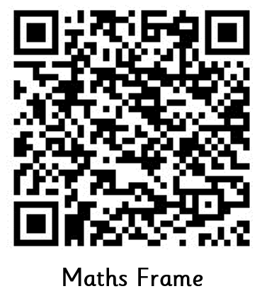
The Assessment
To give you an understanding of how your child will be assessed, we though that you might like to have a go at the task yourselves!
Don’t worry!
You won’t need to share your results with anyone else!
It’s just a bit of fun!

Slide 5
Times Table Rock Stars (TTRS).
There is lots of great stuff (almost too much!) but to help you make the most of this fantastic resource, we have narrowed down the key areas for you to focus on with your child.
Times Tables Rock Stars: Play (ttrockstars.com)

Slide 6
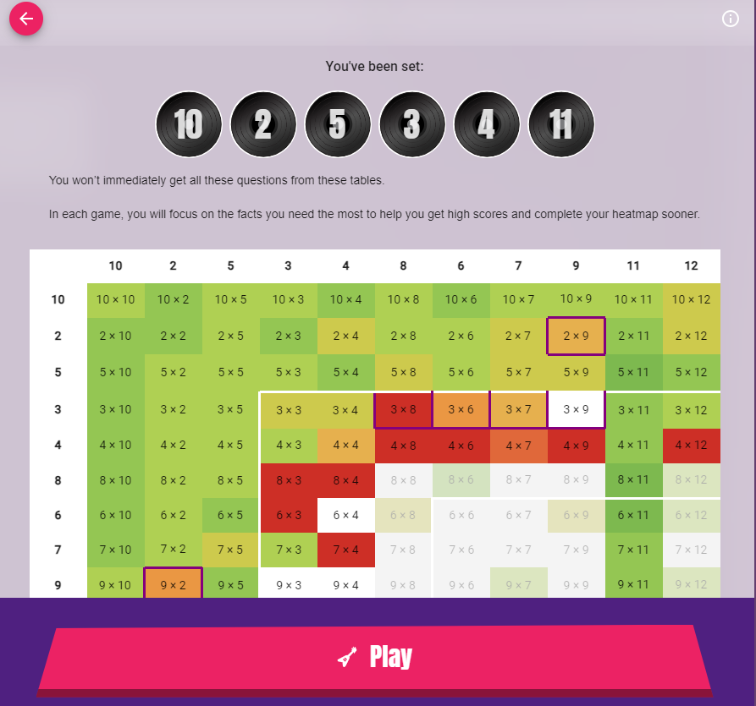
Times Table Rock Stars: Garage
‘Garage’ to play games with will allow the children to practise the times tables that we have set for them. You will be able to see their progress by viewing their heatmaps.

Slide 7
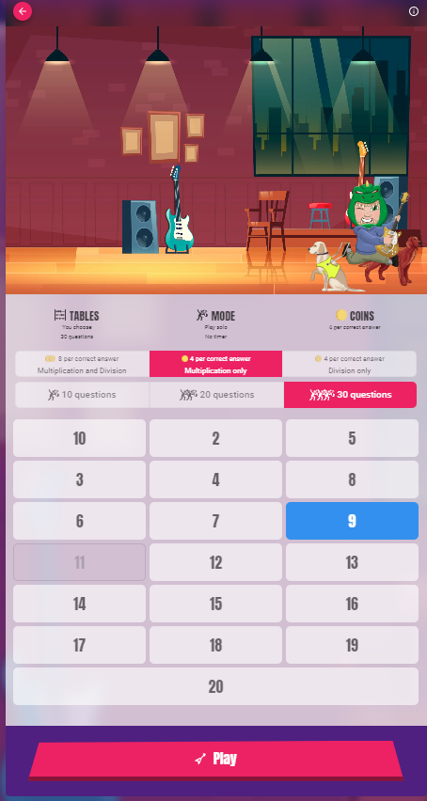
Times Table Rock Stars: Jamming
‘Jamming’ Children can choose the tables that they want to practise and choose other options including division.

Slide 8
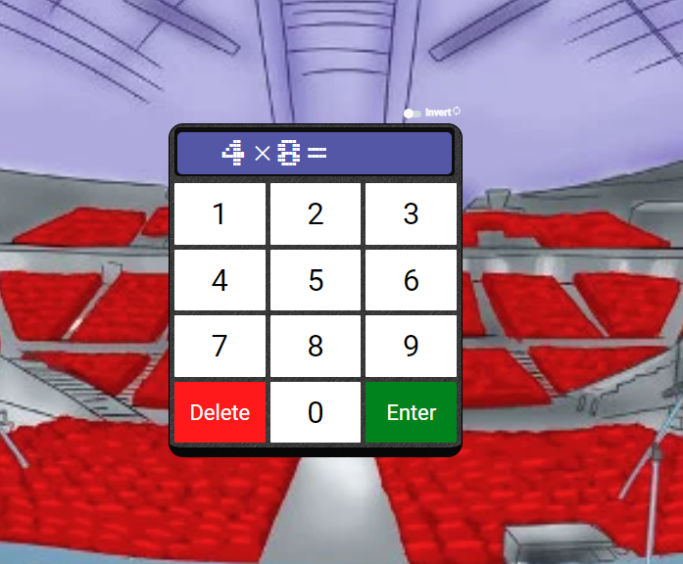
Times Table Rock Stars: Sound Check
‘Sound Check’ This is similar to Maths Frame multiplication check.

Slide 9
Your Turn To Explore:
You have your child’s log in details.
Log in and explore the platform for yourselves.
Check out their heatmap (Garage).
Have a look at the tables they have set themselves (Jamming).
Times Tables Rock Stars: Play (ttrockstars.com)

Slide 10
Nailing Those Tables!
Little and often!
Don’t try to learn the whole table all at once. Break it down into sections: 1 – 4 x, 5 – 8 x, 9 – 12 x.
Find times when you can have a game of times tables – perhaps on a car journey.
Log onto TTRS and Maths Frame regularly to play a game or check heat maps with your child
Flash cards
Songs and rhymes: Times tables collection - BBC Teach or Percy Parker

Slide 11
How we will continue to support your child through the Multiplication Check
A baseline assessment has been completed using the Maths Frame Multiplication Checker (the results of which have been given to you).
Weekly times tables lessons take place on a Friday whereby children have the opportunity to actively learn multiplication facts and access TTRS.
Multiplication checks will be repeated half-termly so that children can get used to the format and the speed of questions. This will also be used to measure the progress of each child throughout the year.
Some children will receive targeted intervention aimed at improving their recall of multiplication facts.

