Slide 1
Let us start by saying:
We are really excited
to be working with
you and your children!

Slide 2
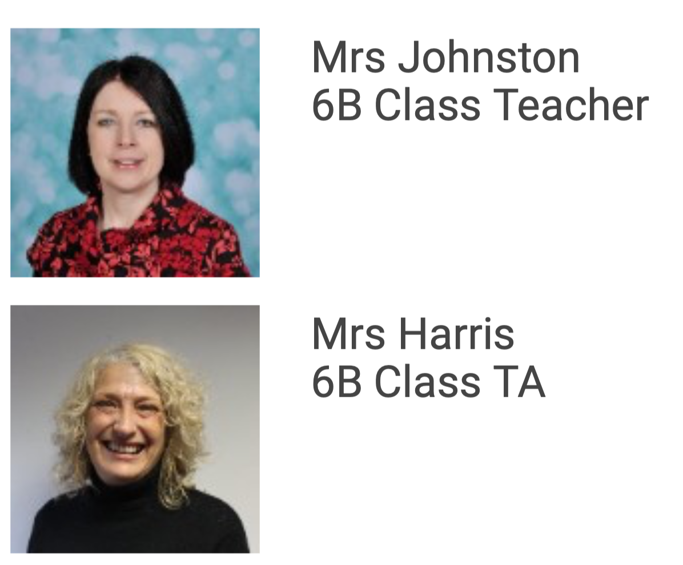
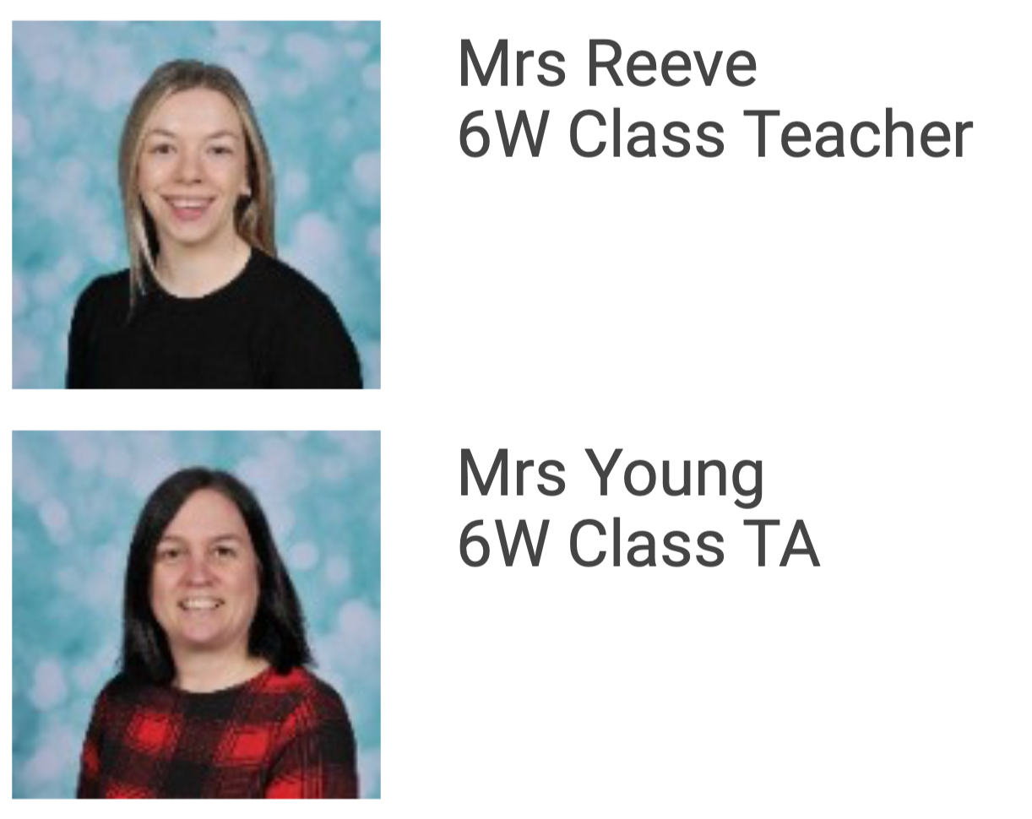
Meet our Year 6 Team

Slide 3
Our school rules:

Slide 4
rewards
If you exceed the expected behaviours…
expected behaviours
If you don’t meet the expected behaviours…
Reminder
Warning
sanction

Slide 5
rewards
House points – in your book you might see 1HP
Recognition board
Happy mail
Shining stars
Phone call home to parents
Golden time
Extra Playtime

Slide 6
sanctions
Time out of class e.g. wet area, another teacher
Reset Room – lunchtime
Phone call home
SLT involvement
Loss of privileges e.g. sitting on benches in assembly

Slide 7
Phones
Phones are collected in when the children arrive at school and redistributed at the end of the school day.

Slide 8
Water bottles
We actively encourage the children to drink. Children should bring a filled water bottle to school with them and keep it in the classroom. There is a box in each room, which they can access at any point during the day.
Bottles are taken outside during break, lunch and PE.
We encourage the children to refill their bottles during break times and come to school with a full bottle to maximise learning time.

Slide 9
Daily Timetable
When the children arrive at school, before the register is taken, they complete Maths Morning Fluency Work.
Our first lesson is Maths then into Guided Reading.
Straight after break, we go into an English lesson and finish the morning with Spellings.
Wider curriculum topics are covered in the afternoon lessons.

Slide 10
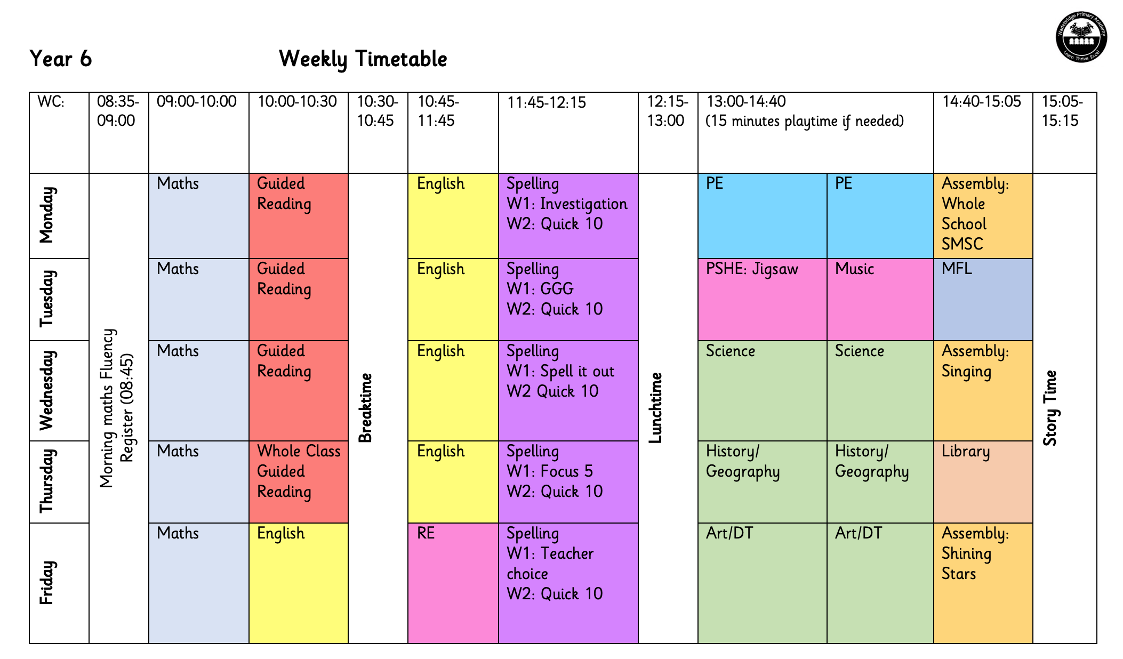
Our PE day is now on Monday.
Please ensure your children wear their PE kit to school on Mondays.

Slide 11
Swimming
We will be swimming from Wednesday 27th September until Wednesday 1st November (5 weeks excluding the half term week).

Slide 12
Home Learning
At home, please encourage your child to:
Read regularly and fill in their reading record.
Use TTRS to learn/embed their times tables.
Complete weekly homework – this will alternate between a SPAG and maths worksheet.
Use Nessy (if they have an account).
Optional choosing grids will be available every term, these are activities that will be linked to our Wider Curriculum learning. Work completed will be shared and celebrated in class.

Slide 13
Year 6 Topics
Autumn Term – World War 2
Spring Term – Evolution
Summer Term – Ancient Greeks

Slide 15
Year 6 Residential Trip 2024
Bristol
3 days and 2 nights
Mrs Orme, who has organised this,
will explain more…

Slide 16
Any questions?
We are going to have a great year!
Throughout the year, if there is anything you would like to discuss with us please feel free to pop in for a chat, leave a message at the school office or email secretary@wadebridgeprimary.co.uk

