Slide 1
Year 4 Residential Porthpean oec

Slide 2
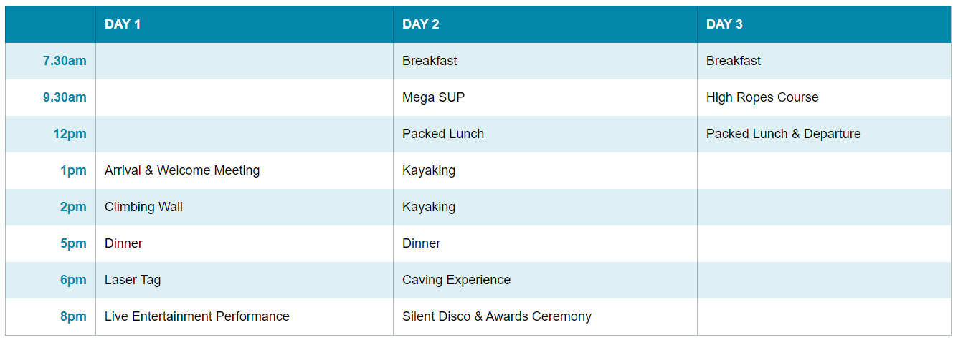
Timings
Monday 1st July – Wednesday 3rd July
Arrive at school with all your kit at the usual time and we will return a little earlier than the end of the school day and children can be collected from 2:00pm

Slide 3
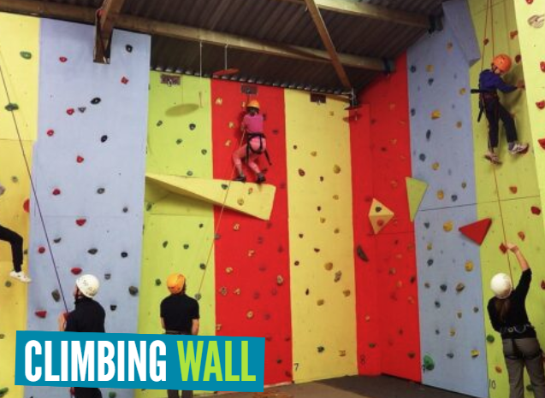
Activities

Slide 4
Activities

Slide 5
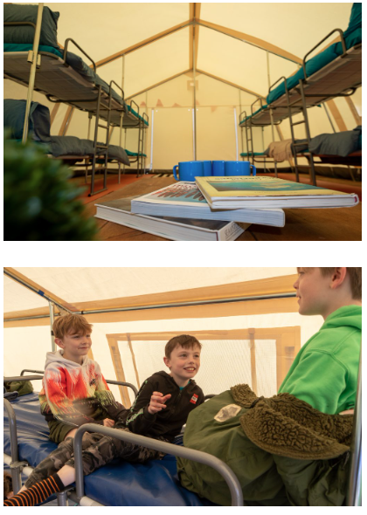
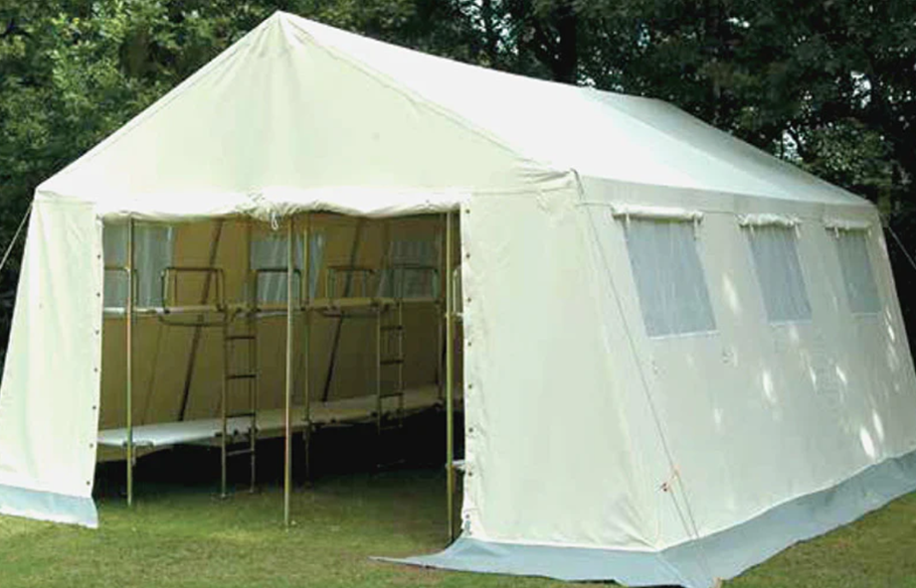
Accommodation
SLEEPING UP TO 12 CHILDREN, OUR BUNKHOUSES OFFER A HUGE 30M² OF LIGHT AND AIRY SPACE TO MOVE AROUND IN. EACH BED IS OFF THE GROUND, MEANING A WARMER AND DRYER SLEEPING EXPERIENCE FOR ALL GUESTS, WITH MATTRESSES COVERED WITH A HYGIENIC WIPE CLEAN MATERIAL. UNLIKE MOST TRADITIONAL TENTS, YOU’LL FIND LOTS OF SPACE FOR KIT STORAGE AND CUSHIONED RUBBER FLOORING, ENSURING A SOFT AND COMFORTABLE UNDERFOOT EXPERIENCE.
ADDITIONAL FEATURES INCLUDE:
LOW LEVEL LIGHTING
HEADSPACE TO SIT ON THE BEDS AND CHILL
LARGER BED THAN STANDARD CAMP BED
SHOE RACK (TO KEEP THE FLOOR NICE AND CLEAN!)

Slide 6
NIGHTTIME
THE CENTRE WILL BE SECURED EVERY NIGHT
A MEMBER OF THE PORTHPEAN OUTDOOR TEAM WILL BE AT THE CENTRE OVER NIGHT.
THEY WILL HAVE AN ENHANCED DBS CERTIFICATE
THEY WILL BE FULLY TRAINED IN OUR SAFEGUARDING POLICY
THEY WILL BE AVAILABLE SHOULD THEY BE NEEDED
THE CENTRE HAS SECURE BOUNDARIES (SLEEPWALKERS WILL HAVE A SAFE AREA FOR NIGHTTIME STROLLS!

Slide 7
Food
OUR CATERING TEAM ENSURE OUR GUESTS ARE WELL FED WITH DELICIOUS, ENERGY PACKED MEALS TO PREPARE THEM FOR THE ADVENTURES AHEAD.
ALL RESIDENTIAL PACKAGES INCLUDE A COOKED BREAKFAST EACH MORNING, LUNCH ON EACH FULL DAY AND ON YOUR DAY OF DEPARTURE, AND EVENING MEALS WITH A MAIN COURSE AND DESSERT.
AS MUCH FOOD AS POSSIBLE IS HOMECOOKED BY OUR AMAZING CATERING TEAM, SERVED FROM OUR FULLY-EQUIPPED COMMERCIAL CATERING KITCHEN.
DIETARY REQUESTS ARE ACCOMMODATED WITH ADVANCE NOTICE. WE WILL WORK WITH THE SCHOOL, IN COLLABORATION WITH THE LEAD TEACHER, TO CAPTURE ALL FOOD ALLERGIES AND DIETARY NEEDS TO ENSURE EVERYONE IS HAPPY AND ENERGISED DURING THEIR STAY.

Slide 8
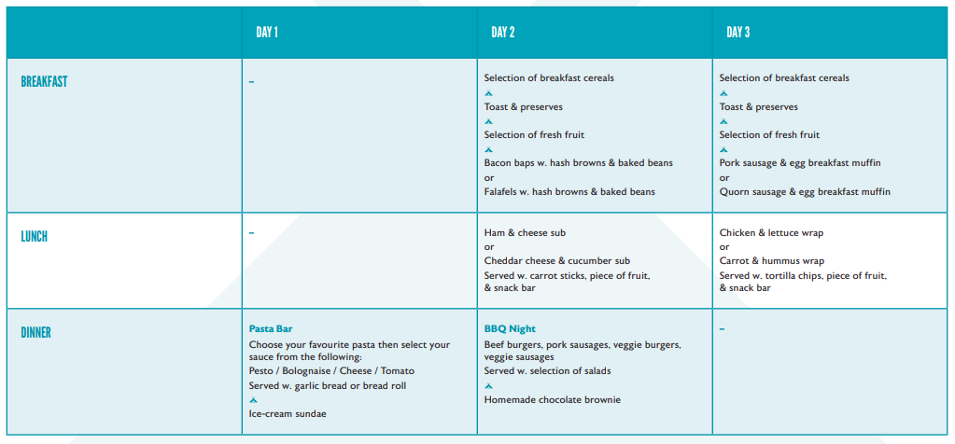
Food

Slide 9
Kit
WHAT TO BRING WITH YOU
WE ASK ALL CHILDREN TO LEAVE THEIR PHONES/SCREENS AT HOME. THIS IS TIME TO CONNECT WITH FRIENDS, TEACHERS, AND THE OUTDOORS.
Please do not bring any sentimental items, and expect clothing and footwear to get A LITTLE BIT messy!
We can store any required medical equipment or medicines in the boardroom or in the teacher camping pod, if necessary.
Any lost property will be stored at the centre for collection for a period of 28-days after your stay.

Slide 10
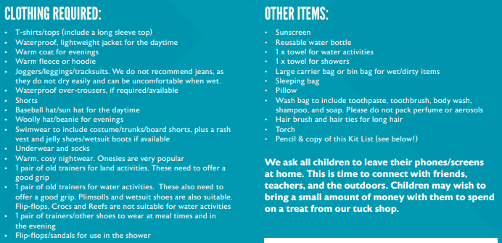
Kit

Slide 11
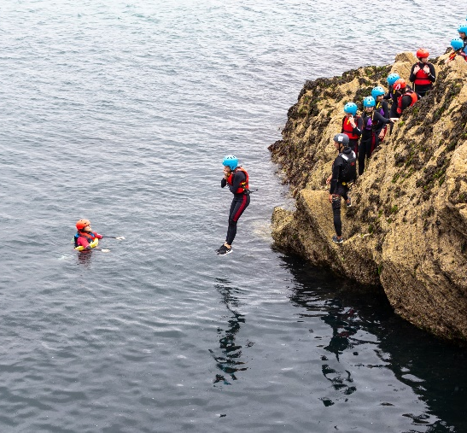
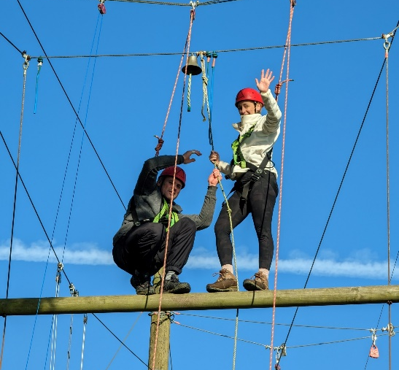
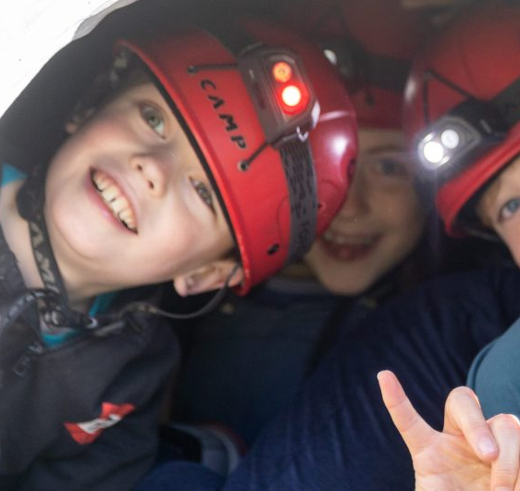
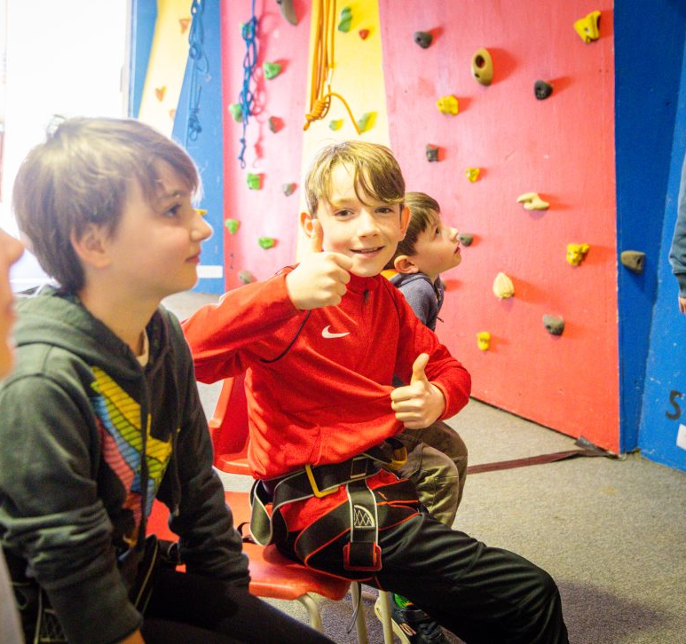
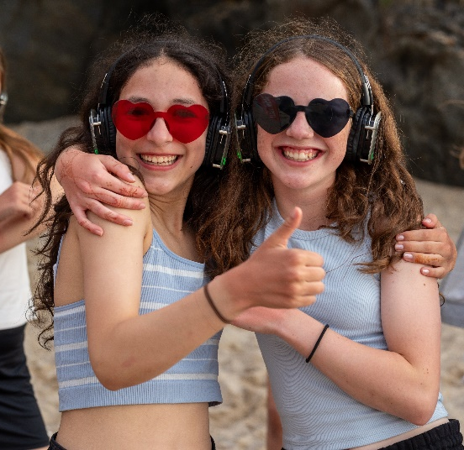
SMILES ALL AROUND!

Slide 12
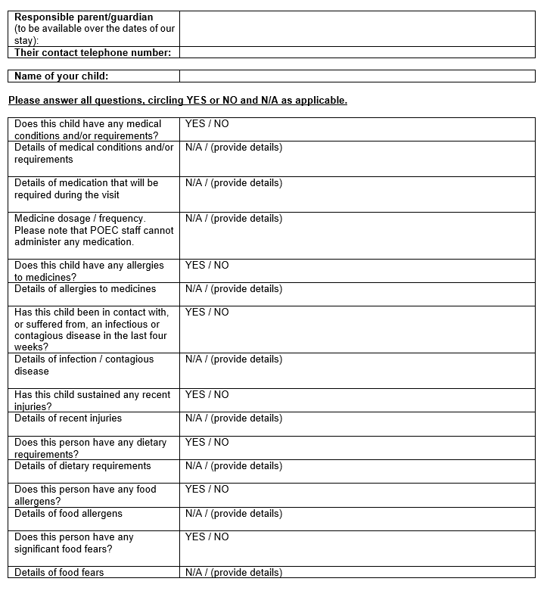

Slide 13
Be Safe, Be Ready, Be Respectful.
Be Safe
Stay with your group and adult
Follow the adults instructions
Use all equipment safely
If you need anything in the night wake an adult

Slide 14
Be Safe, Be Ready, Be Respectful.
Be Ready
Bring a packed lunch and drink for the first day
Bring suitable footwear
Bring old clothes
Remember toiletries and towel
When adults are speaking; look, stand still and listen

Slide 15
Be Safe, Be Ready, Be Respectful.
Be Respectful
Keep voices quiet so as not to disturb others
Take all litter home with you
Leave nature as you found it
Look after any equipment
Be supportive and encouraging of others

Slide 16
We will experience loads of new things and have a great residential. Please think about who you would like to share your bunkhouse tent with and write down 3 names on the piece of paper.

