Slide 1
Welcome to Year 4!
Meet the teacher 13.09.23

Slide 2
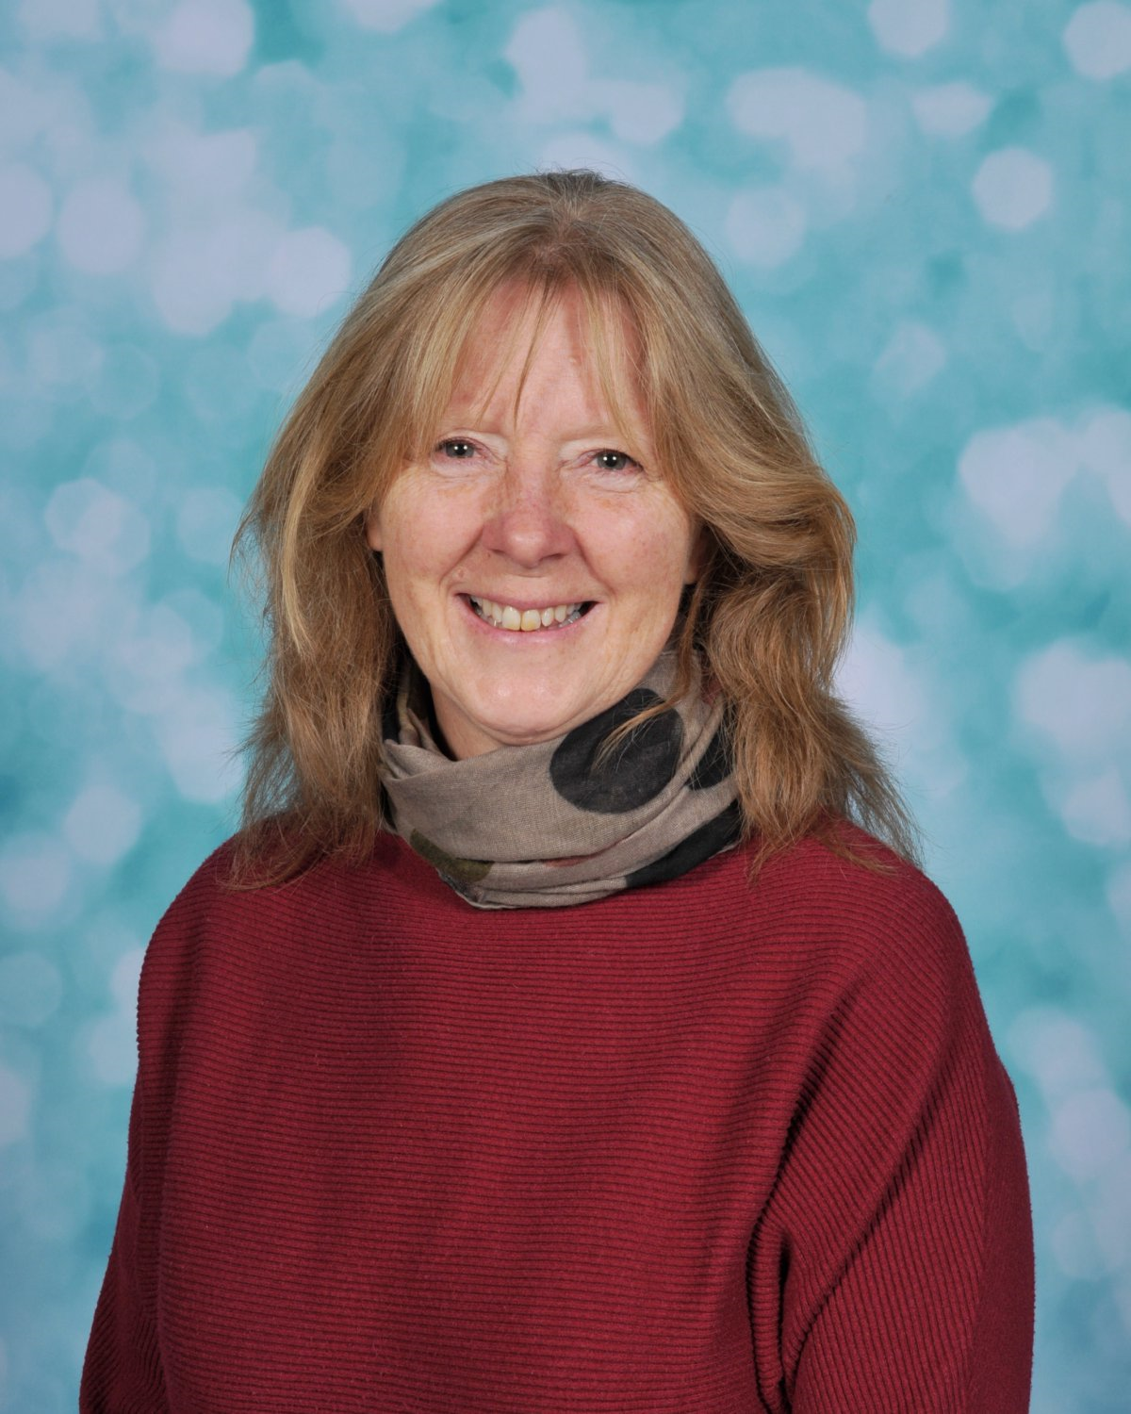
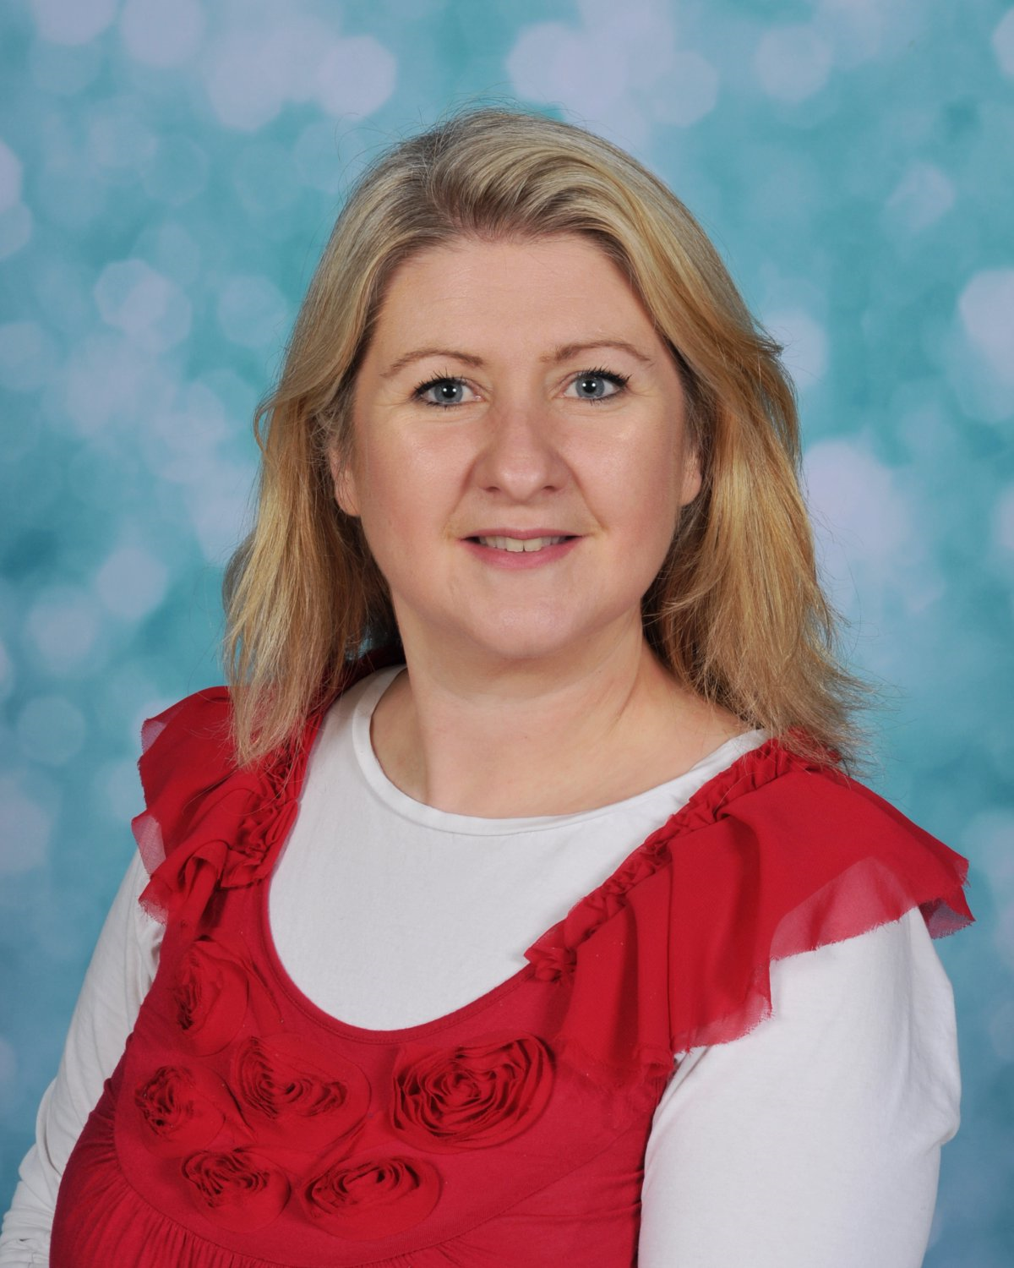
Year 4 – Our team
4B: Mrs Keat (class teacher) & Ms Christian (TA)
4W: Mrs Hill (class teacher) & Ms Blue (TA)

Slide 3
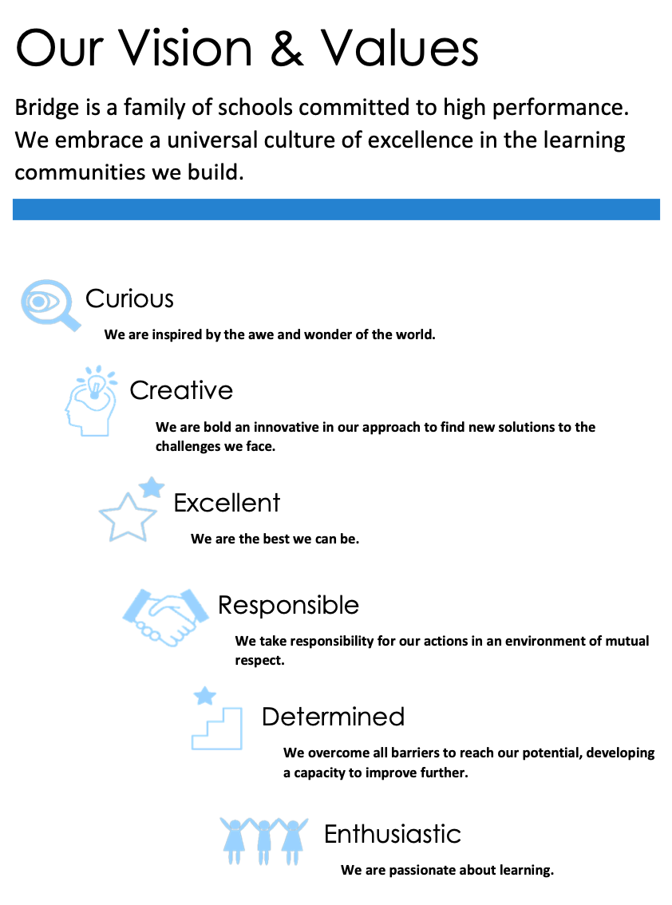
Classroom expectations
Be Safe
Be Respectful
Be Ready

Slide 4
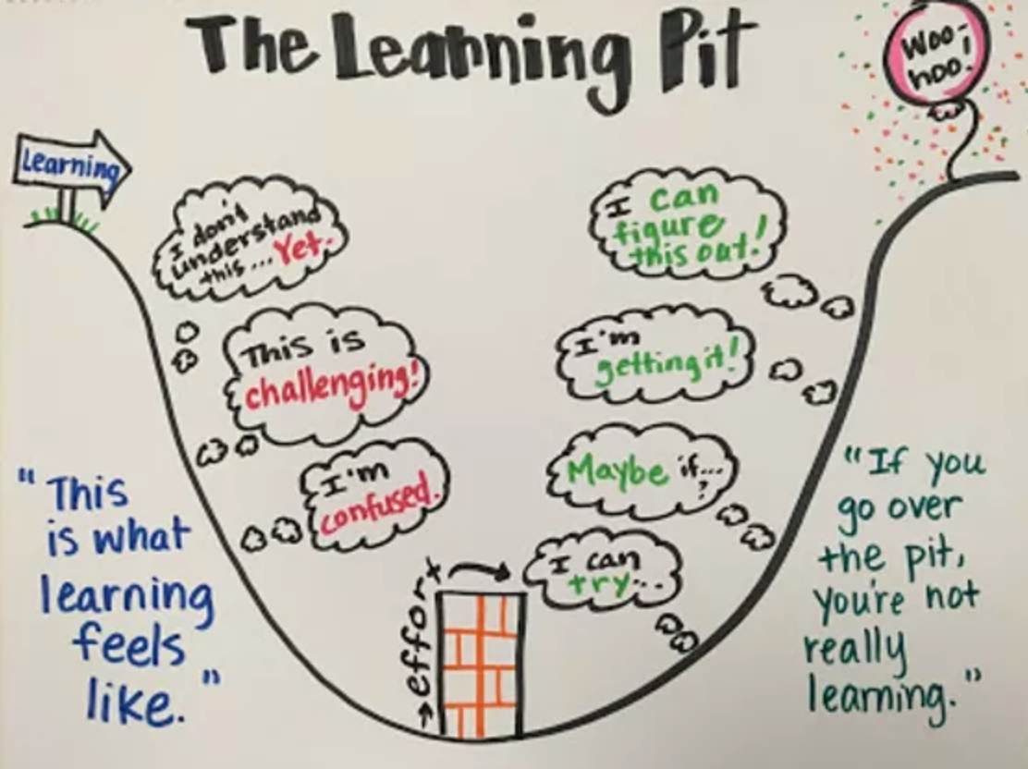
Developing metacognition
Learning to Learn
To help children understand the process of and build resilience for learning, we continue to refer to our Learning Characters which link with our Trust Values:
Curious: Find our Flamingo
Creative: Ideas Iguana
Responsible: Teamwork Turtle
Determined: Keep Going Koala
Enthusiastic: Have a Go Hippo
We talk to the children about the learning process and how it shouldn’t be an “easy ride”. Deep learning involves set backs, feelings of uncertainty and requires effort. Mistakes are embraced and shared freely in order to deepen learning.

Slide 5
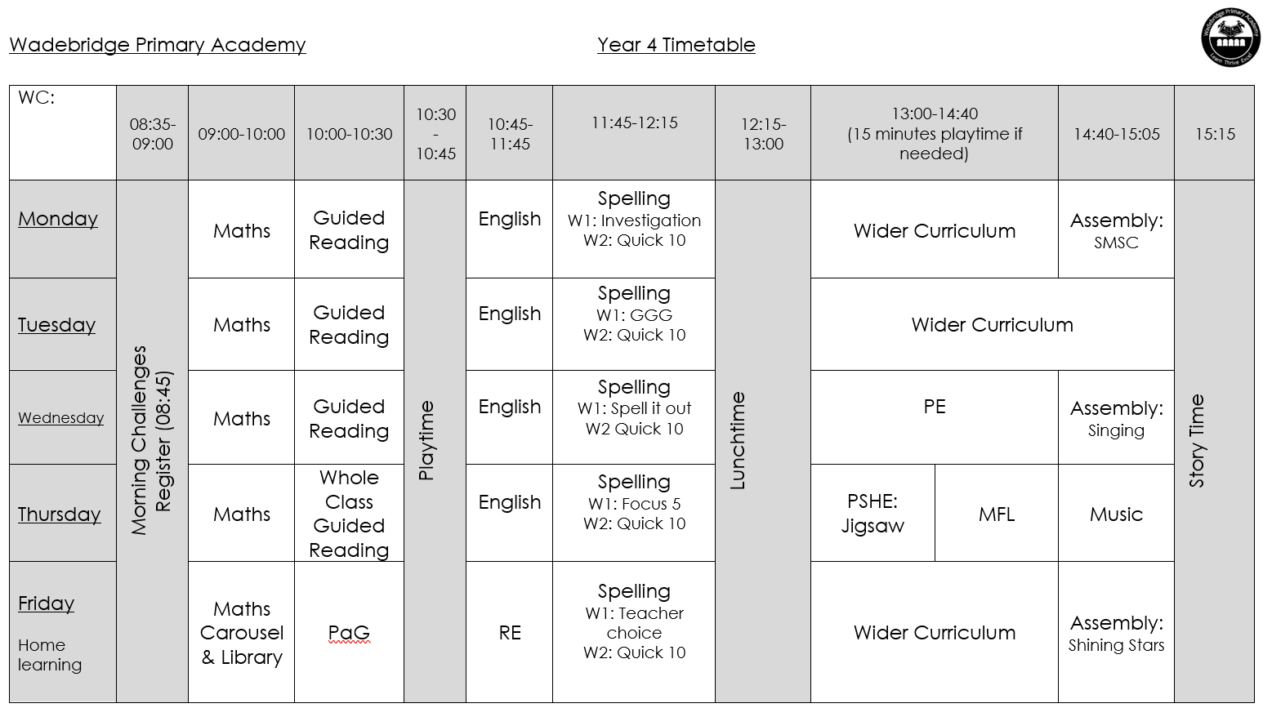
Our Timetable

Slide 6
Autumn term topic: Anglo-Saxons and Vikings
Were they only raiders and invaders?
Most of our Wider Curriculum lessons will be incorporated into this topic.
PE, RE, PSHE, French and Music are taught discretely.
Our Wider Curriculum Learning Journey is available to view on the class webpage.

Slide 7
Home Learning
In addition to the optional homework grid, a weekly piece of home learning will be set. This will be the same as Year 3 in that Maths and PaG (Punctuation and Grammar) tasks will be set on alternate weeks.
Home learning will be given to take home on a Friday and should be returned to school no later than the following Friday.
All effort will be made to ensure that home learning tasks are set at an appropriate level for your child.
Wherever possible, copies of homework can be found via our class blog on the website.

Slide 8
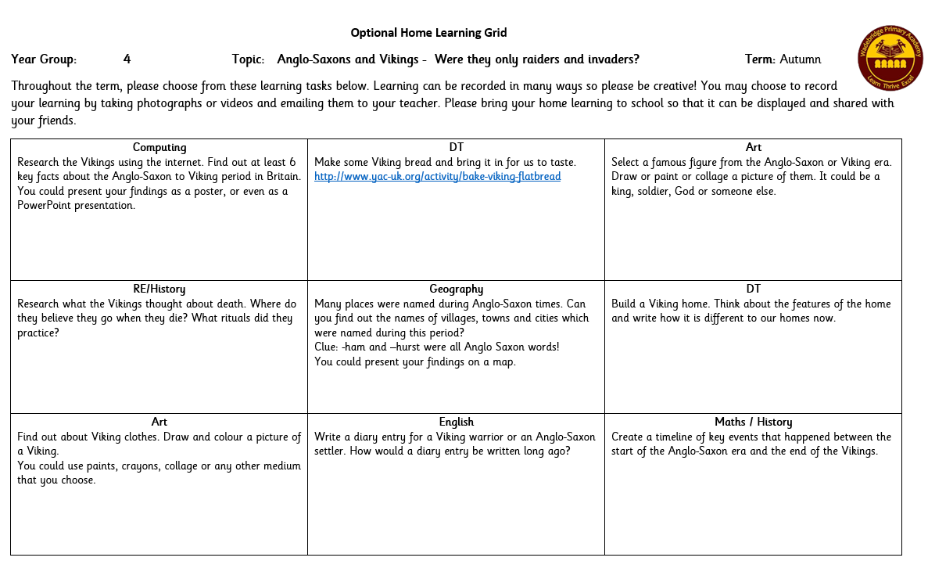

Slide 9
Reading at home
Three reads at home:
Please read with your child as often as you can and record in their Reading Record.
As well as encouraging fluency and expression when they read, use VIPERS to develop comprehension skills. Please see the additional guidance.
Please make sure your child brings their reading packets to school every day.

Slide 10
Times tables
At the end of Year 4, children will be required to take part in statutory Times Tables Assessments and so we strongly encourage times tables practise at home.
Children take part in weekly times tables lessons (Friday).
Maths Frame Times Tables Check is a free website that mimics the statutory assessment very closely Multiplication Tables Check - Mathsframe

Slide 11
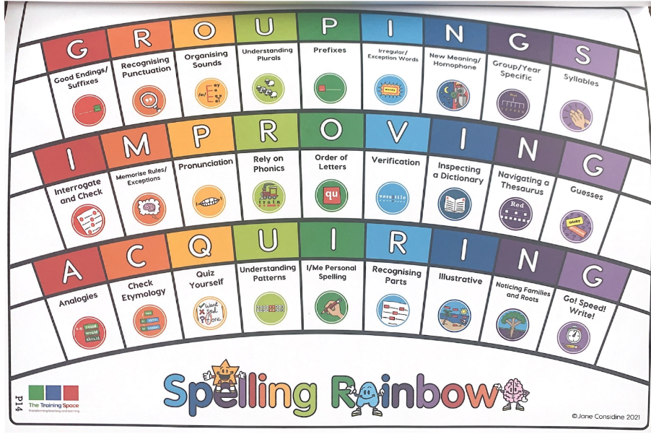
Spelling
At Wadebridge Primary Academy, we feel strongly about supporting children to be brave spellers. We understand the importance of children learning to spell correctly, but we also want to engage and inspire children with a love of words. This is why we have implemented the Jane Considine approach to spelling which puts the children's love of words at the heart of learning to spell.
Lessons encourage children to look deeply at words, draw and build upon their knowledge of phonics from KS1 and make connections with spellings or letter patterns that they may already know.
Spelling lessons are structured carefully around a two-week timetable which include a range of activities based upon the Spelling Rainbow which draw upon a number of skills children need to develop in order to become good spellers.
Children are not sent home with weekly spellings to learn. Jane Considine says, “What we need to do is keep everything within schools, so we don’t build up the anxiety.” Through the daily spelling sessions in school, your child will become effective word detectives and use their deeper knowledge of words to make plausible spelling choices in their writing.
If you would like to support your child with learning spelling patterns, you may find the year group overviews useful. You could also ask your child to tell you which words are on their ‘Focus Five’ and support them with these individual words.

Slide 12
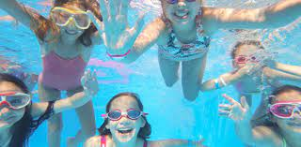
PE Day: Wednesday (usually)
Please ensure your child wears their P.E. kit to school on a Wednesday.
Swimming will take place on Mondays from 25.09.23 for 5 weeks. Please ensure your child brings:
A swimming costume
A towel
Goggles
When it is our turn for Pro-20, our PE day will change to a Monday for that half term.
Year 4 are due to have Pro20 in Spring 2.

Slide 13
Library
.Our Library session is on a Friday morning. Every child will be issued with a library book in addition to a banded reading book.

Slide 14
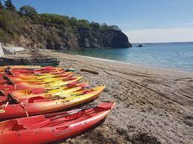
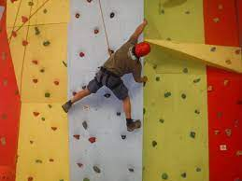
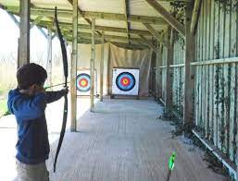
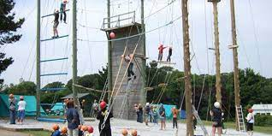
Possible residential opportunity!
We are really excited to be considering a Year 4 residential trip which will take place possibly in July next year for two nights.
Pre-Covid 19, we visited Porthpean annually and had many, many successful trips which were popular and incredibly beneficial for all who attended.
More details in the letter handed out today.
If you have any questions, please do not hesitate to ask.

Slide 15
If there is anything you would like to discuss with us please feel free to pop in for a chat, leave a message at the school office or email secretary@wadebridgeprimary.co.uk Thank you so much for taking the time to attend ☺

