Slide 1
Welcome to Key Stage 2!
Year 3 2023-2024

Slide 2
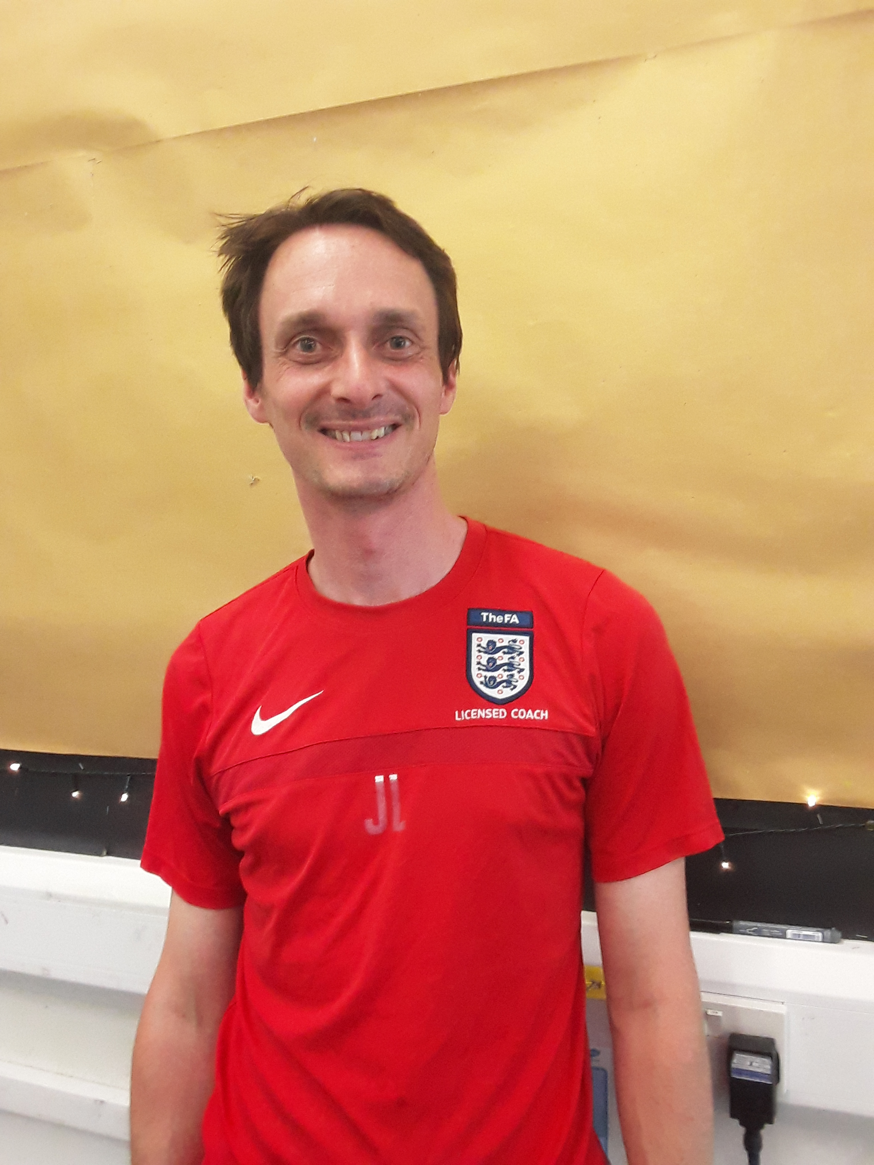
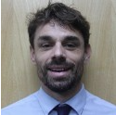
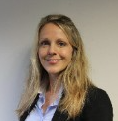
Our Year 3 Team
Tas
3W:Mrs Hodkinson
Mrs Bryant
Miss Wotus
3B: Mrs Jeffrey
3W
Mr Robey
3B
Mr Langton & Miss May
(Monday – Wednesday) (Thursday - Friday)

Slide 3
The School Day
Registration is at 8.45am and collection at 3.15pm This is slightly longer than the children will be used to!
Children will come in to school via the green gate leading to the Key Stage 2 classrooms, enter the cloakroom where they will hang their belongings and wash their hands before entering the classroom.
The gate will open at 8:35am
Break will be at 10.30 when children will be able to have a drink and a snack as well as a play in the Year 3/4 playground.
Lunch will be at 12.15 and last for 45 minutes.
Children will leave school via the green gate at 3.15pm.

Slide 4
Learning in Year 3
Just like in Key Stage 1, we will have topics during which we will do lots of our wider curriculum learning.
Our first topic question will be:
“Is the Earth a force to be reckoned with?"
where we will be looking at the science behind how the Earth is made up with a geographical focus on natural disasters; where these happen and why.
Guided Reading and Writing lessons will happen daily, just as in Year 2. Sometimes these lessons are linked to our topic, sometimes they stand alone.
Maths will continue in the same way as KS1 but with extra emphasis on Times Tables.
In Key Stage 2, we start learning a new subject: French!
In PE this term we will be undertaking gymnastics, rugby, swimming, fitness and football.
The children can wear PE kits on Mondays. Swimming is for 5 weeks on Thursdays from 28th September.
Notes:
SJ

Slide 5
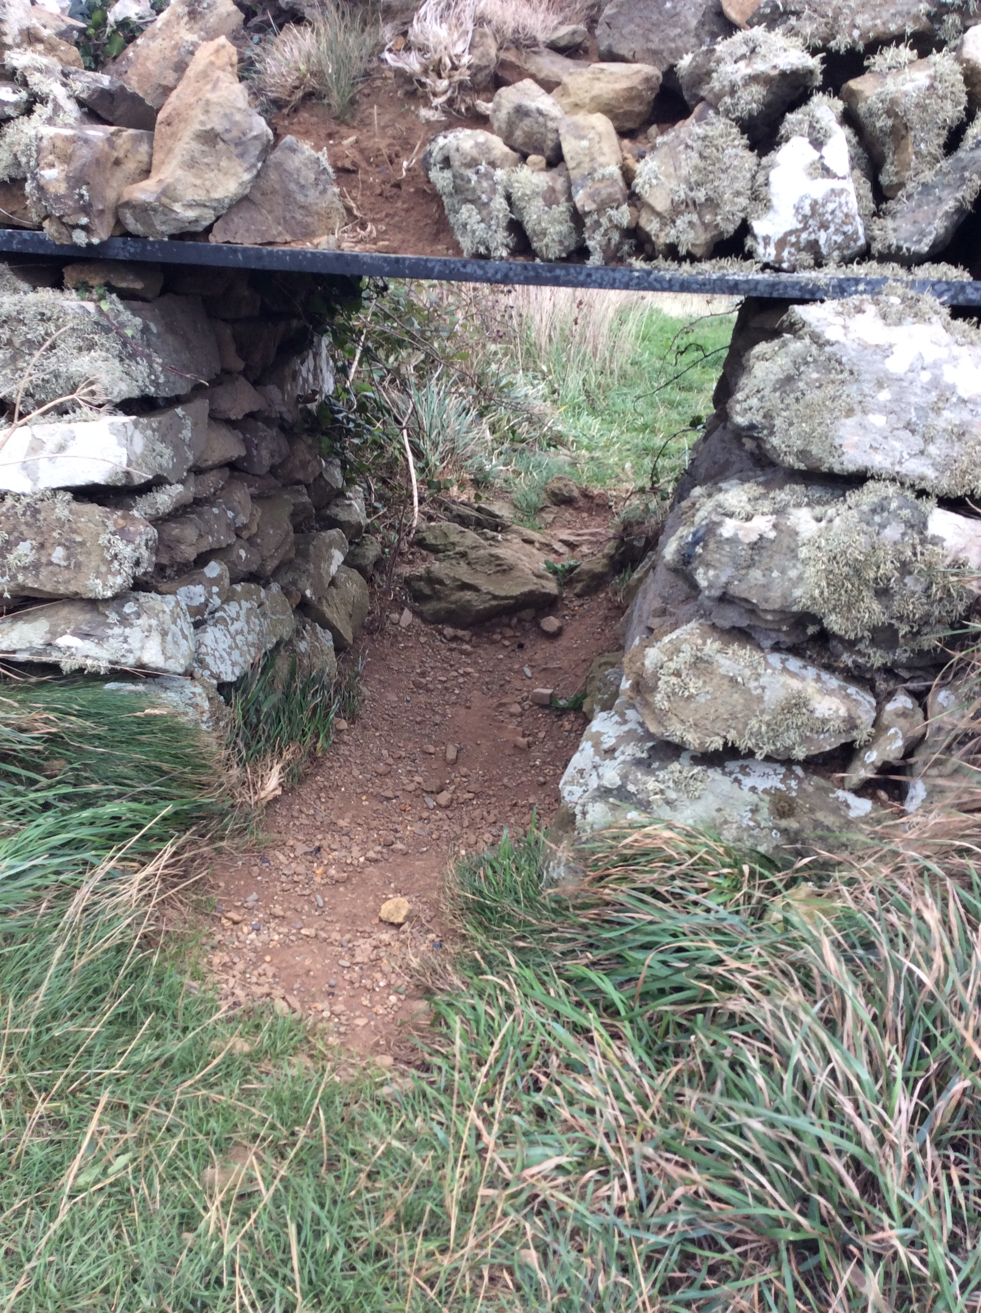
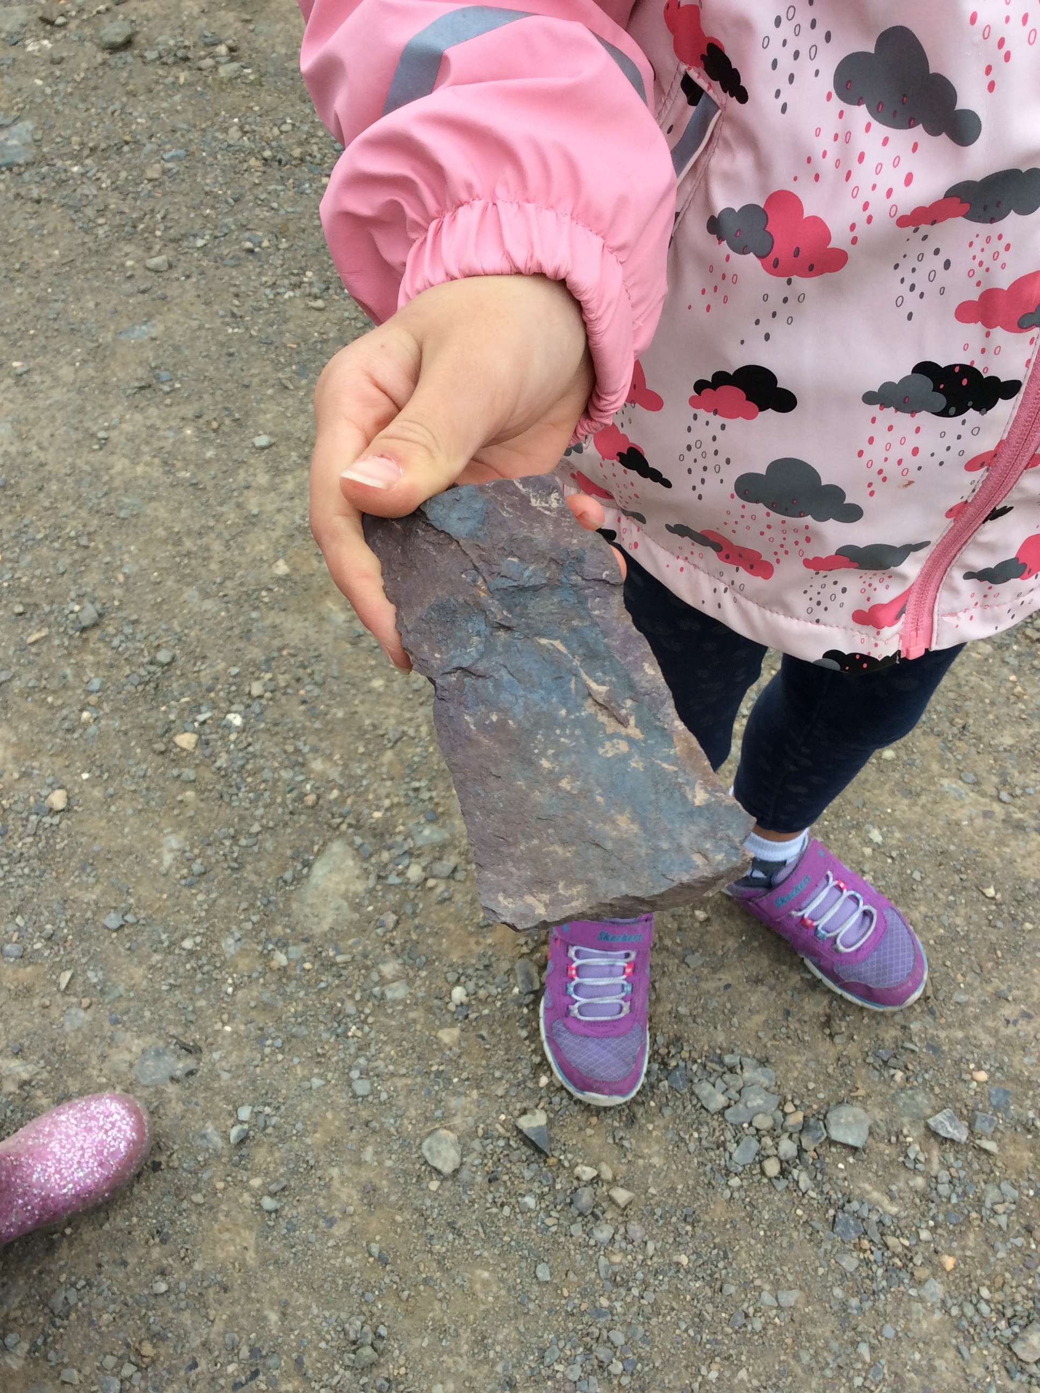
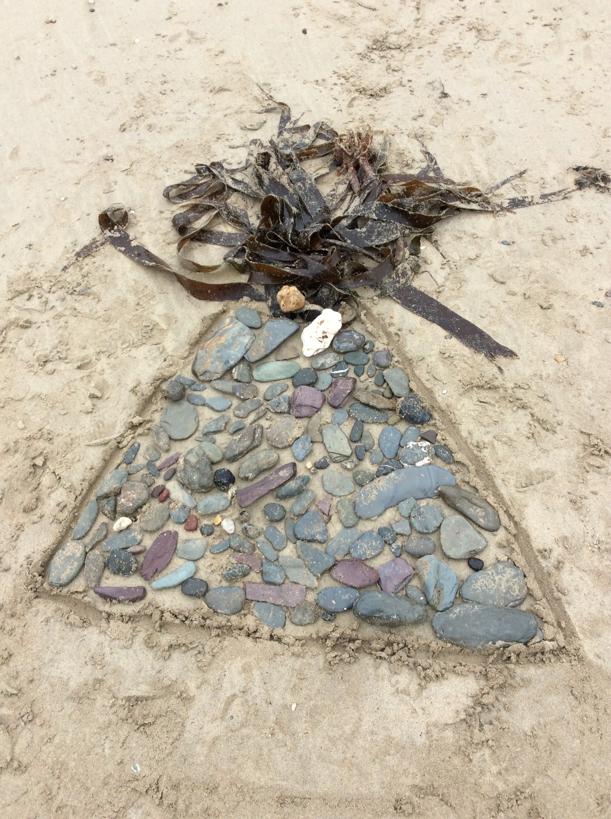
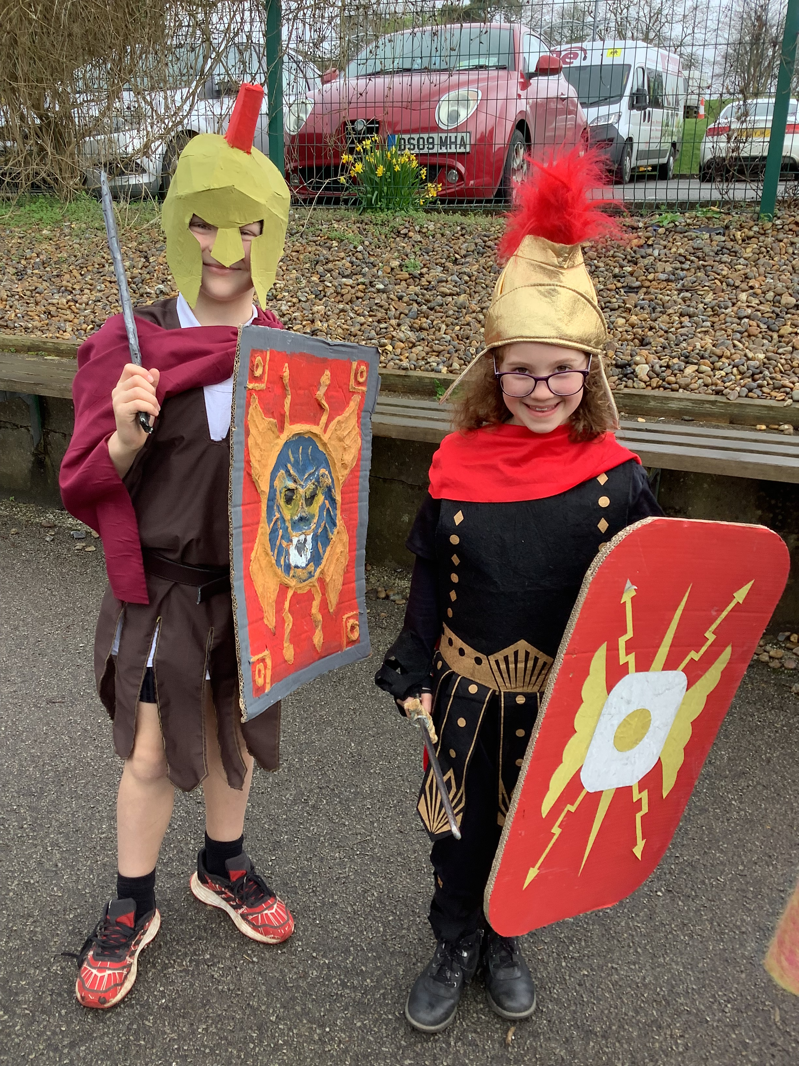
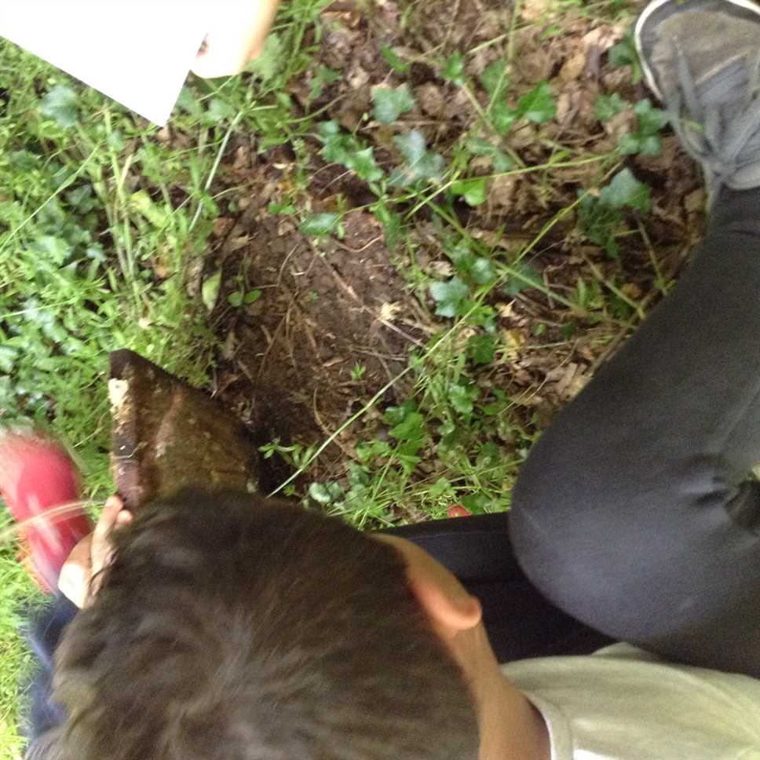
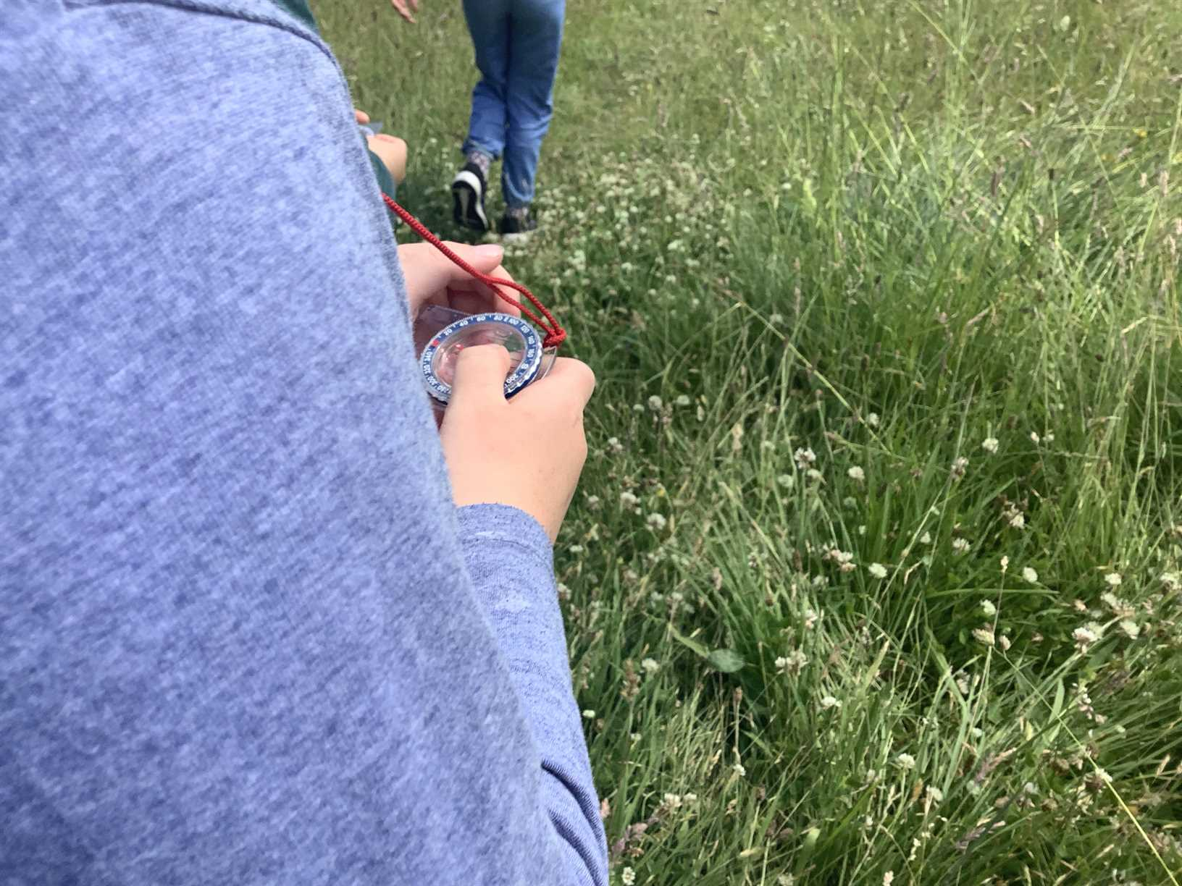
Educational Visits
Over the course of Year 3 we are hoping to have a range of educational visits. They could include:
Pentire
Roman wow day
Geography fieldwork
Overnight stay
Plus any other opportunities!
Parent volunteers

Slide 6
Home Learning
Times Tables; children will be required to take part in statutory assessments at the end of Year 4. With this in mind, we make a start early by conducting weekly tables assessments. The best way to learn tables is by chanting them repeatedly – honestly, it works! Times Tables Rock Stars is an online platform which can be used to support learning in maths. Login details for this can be found in your child’s Reading Record.
Regular reading. Please read regularly with your child at home. On a Friday we will check reading records and if your child reads regularly, they will receive a golden ticket.
Optional Topic Learning grids will also be available each term which will give children an opportunity to be a little more creative with their learning; it could be that children decide to bake something topic-related or do some research, draw a picture or create a collage.
On some occasions we will send additional homework sheets home to be completed.
Notes:
We recognise the important impact home learning has upon children’s progress as well as providing an important link between home and school. The Education Endowment Foundation has researched the impact of home learning upon children’s progress and on the whole, this has an increase rate of two months’. This means that children should make an additional two months’ progress by completing home learning tasks regularly.

Slide 7
Meals, snacks and drinks
Children are no longer entitled to a free school meal as they have been in Key Stage 1. However, they are still able to have a school meal which can be paid for in advance via ParentPay: ParentPay - The Leading Cashless Payments System for Schools. Children who are entitled to Free School Meals will not be charged for a school meal. You can apply for Free School Meals via this link: School meals - Cornwall Council
You will also need to send a snack in to school with your child for morning play. However, please consider the snack choices carefully as we are part of the Healthy Schools initiative and so any snack you send in with your child should be fresh fruit or vegetables. Fruit winders/cereal bars do not count as a healthy snack. We would also like to remind you that we are a nut-free school so any snacks that contain nuts are not permitted. If you have any problems, please speak to a member of the team.
As with Year 2, please continue to send your child in to school with water in a named bottle. They will have many opportunities to re-fill their bottles throughout the day if needed.
Notes:
If you require any assistance with your ParentPay account, please contact a member of our admin team.

Slide 8
Communication
Communication is vital in the success of your children in school. We try to give as much information as possible in these ways:
Check out the Year 3 webpage on the school website and the schools facebook page,
Request a telephone appointment,
Email
Weekly Head’s Blog
Texts & emails from school with important updates
Please remember, you can always pop and see us at the end of the day when you collect your child, We are a very approachable team!

Slide 9
Do you have any questions for us?

